Slide 1


TABLA DE 10
Colorea los múltiplos del 10
10 | X | 1 | = | _____
10 | X | 2 | = | _____
10 | X | 3 | = | _____
10 | X | 4 | = | _____
10 | X | 5 | = | _____
10 | X | 6 | = | _____
10 | X | 7 | = | _____
10 | X | 8 | = | _____
10 | X | 9 | = | _____
10 | X | 10 | = | _____
10 | 20 | 30 | 13 | 17 | 31
16 | 24 | 40 | 15 | 46 | 25
19 | 32 | 50 | 48 | 56 | 49
1 | 2 | 60 | 70 | 80 | 90
11 | 17 | 41 | 13 | 37 | 100
Completa la rueda
10 | X | 2 | = | _____
10 | X | 4 | = | _____
10 | X | 3 | = | _____
10 | X | 5 | = | _____
10 | X | 6 | = | _____
10 | X | 7 | = | _____
10 | X | 9 | = | _____
10 | X | 8 | = | _____
10 | X | 1 | = | _____
10 | X | 10 | = | _____
100
1
9
2
10x
3
80
7
5
40
60
Completa la secuencia de los múltiplos del 10
0 |  | 10 |  |  |  |  |  |  |  |  |  | 60
Proyecto Colaborativo TabliLocas

Slide 2

TABLA DE 9
Colorea los múltiplos del 9
9 | X | 1 | = | _____
9 | X | 2 | = | _____
9 | X | 3 | = | _____
9 | X | 4 | = | _____
9 | X | 5 | = | _____
9 | X | 6 | = | _____
9 | X | 7 | = | _____
9 | X | 8 | = | _____
9 | X | 9 | = | _____
9 | X | 10 | = | _____
9 | 18 | 27 | 3 | 10 | 31
16 | 24 | 36 | 13 | 46 | 25
19 | 32 | 45 | 48 | 56 | 49
1 | 2 | 54 | 63 | 72 | 81
11 | 17 | 41 | 13 | 37 | 90
Completa la rueda
9 | X | 2 | = | _____
9 | X | 4 | = | _____
9 | X | 3 | = | _____
9 | X | 5 | = | _____
9 | X | 6 | = | _____
9 | X | 7 | = | _____
9 | X | 9 | = | _____
9 | X | 8 | = | _____
9 | X | 1 | = | _____
9 | X | 10 | = | _____
90
1
9
2
9x
72
3
7
5
36
54
Completa la secuencia de los múltiplos del 9
0 |  | 9 |  |  |  |  |  |  |  |  |  |  |  |  |  |  |  | 81
Proyecto Colaborativo TabliLocas

Slide 3
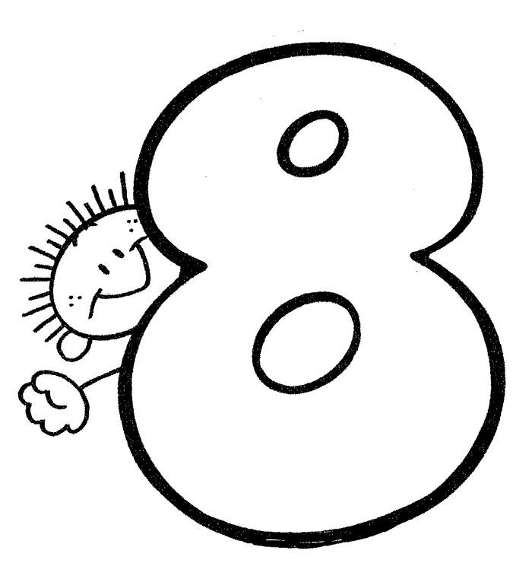
TABLA DE 8
Colorea los múltiplos del 8
8 | X | 1 | = | _____
8 | X | 2 | = | _____
8 | X | 3 | = | _____
8 | X | 4 | = | _____
8 | X | 5 | = | _____
8 | X | 6 | = | _____
8 | X | 7 | = | _____
8 | X | 8 | = | _____
8 | X | 9 | = | _____
8 | X | 10 | = | _____
8 | 12 | 13 | 7 | 10 | 31
16 | 24 | 14 | 13 | 46 | 25
19 | 32 | 40 | 48 | 56 | 49
1 | 2 | 5 | 9 | 64 | 72
11 | 17 | 41 | 13 | 27 | 80
Completa la rueda
8 | X | 2 | = | _____
8 | X | 4 | = | _____
8 | X | 3 | = | _____
8 | X | 5 | = | _____
8 | X | 6 | = | _____
8 | X | 7 | = | _____
8 | X | 9 | = | _____
8 | X | 8 | = | _____
8 | X | 1 | = | _____
8 | X | 10 | = | _____
80
1
16
9
8x
64
3
7
5
32
48
Completa la secuencia de los múltiplos del 8
0 |  |  |  | 16 |  |  |  |  |  |  |  |  |  |  |  |  |  |  |  | 80
Proyecto Colaborativo TabliLocas

Slide 4


TABLA DE 7
Colorea los múltiplos del 7
7 | X | 1 | = | _____
7 | X | 2 | = | _____
7 | X | 3 | = | _____
7 | X | 4 | = | _____
7 | X | 5 | = | _____
7 | X | 6 | = | _____
7 | X | 7 | = | _____
7 | X | 8 | = | _____
7 | X | 9 | = | _____
7 | X | 10 | = | _____
7 | 12 | 13 | 8 | 10 | 31
14 | 21 | 24 | 13 | 46 | 25
19 | 17 | 28 | 35 | 42 | 49
1 | 2 | 5 | 9 | 56 | 63
11 | 17 | 41 | 13 | 27 | 70
Completa la rueda
7 | X | 2 | = | _____
7 | X | 4 | = | _____
7 | X | 3 | = | _____
7 | X | 5 | = | _____
7 | X | 6 | = | _____
7 | X | 7 | = | _____
7 | X | 9 | = | _____
7 | X | 8 | = | _____
7 | X | 1 | = | _____
7 | X | 10 | = | _____
7
9
2
7x
56
3
7
5
28
42
Completa la secuencia de los múltiplos del 7
0 |  | 7 |  |  |  |  |  |  |  | 35 |  |  |  |  |  |  |  |  |  | 80
Proyecto Colaborativo TabliLocas

Slide 5

TABLA DE 6
Colorea los múltiplos del 6
6 | X | 1 | = | _____
6 | X | 2 | = | _____
6 | X | 3 | = | _____
6 | X | 4 | = | _____
6 | X | 5 | = | _____
6 | X | 6 | = | _____
6 | X | 7 | = | _____
6 | X | 8 | = | _____
6 | X | 9 | = | _____
6 | X | 10 | = | _____
6 | 12 | 13 | 8 | 10 | 31
34 | 18 | 24 | 13 | 46 | 25
49 | 7 | 30 | 36 | 42 | 23
1 | 2 | 5 | 9 | 48 | 54
11 | 17 | 41 | 13 | 27 | 60
Completa la rueda
6 | X | 2 | = | _____
6 | X | 4 | = | _____
6 | X | 3 | = | _____
6 | X | 5 | = | _____
6 | X | 6 | = | _____
6 | X | 7 | = | _____
6 | X | 9 | = | _____
6 | X | 8 | = | _____
6 | X | 1 | = | _____
6 | X | 10 | = | _____
1
9
2
6x
48
3
7
5
24
36
Completa la secuencia de los múltiplos del 6
0 |  | 6 |  |  |  |  |  |  |  | 30 |  |  |  |  |  |  |  |  |  | 60
Proyecto Colaborativo TabliLocas

Slide 6
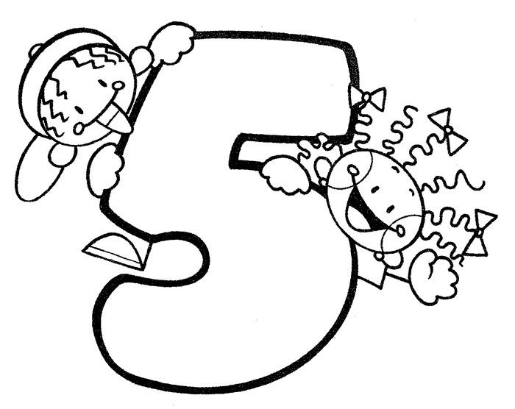
TABLA DE 5
Colorea los múltiplos del 5
5 | X | 1 | = | _____
5 | X | 2 | = | _____
5 | X | 3 | = | _____
5 | X | 4 | = | _____
5 | X | 5 | = | _____
5 | X | 6 | = | _____
5 | X | 7 | = | _____
5 | X | 8 | = | _____
5 | X | 9 | = | _____
5 | X | 10 | = | _____
5 | 17 | 21 | 39 | 21 | 31
6 | 10 | 3 | 33 | 1 | 12
9 | 15 | 20 | 25 | 30 | 35
1 | 27 | 13 | 28 | 41 | 40
11 | 17 | 41 | 13 | 45 | 50
Completa la rueda
5 | X | 2 | = | _____
5 | X | 4 | = | _____
5 | X | 3 | = | _____
5 | X | 5 | = | _____
5 | X | 6 | = | _____
5 | X | 7 | = | _____
5 | X | 9 | = | _____
5 | X | 8 | = | _____
5 | X | 1 | = | _____
5 | X | 10 | = | _____
5
9
2
5x
40
3
7
6
5
20
Completa la secuencia de los múltiplos del 5
0 |  | 5 |  |  |  |  |  |  |  |  |  | 30
Proyecto Colaborativo TabliLocas

Slide 7
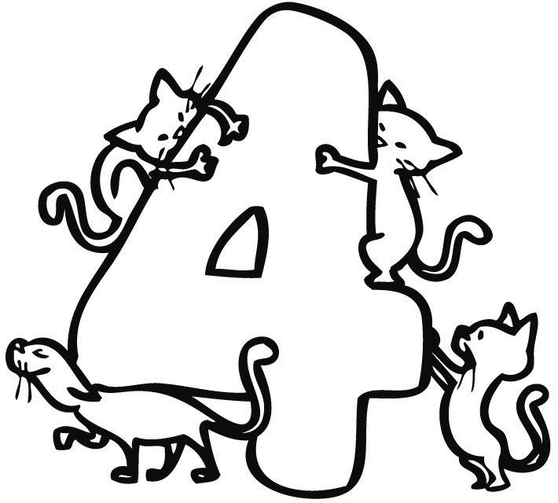
TABLA DE 4
Colorea los múltiplos del 4
4 | X | 1 | = | _____
4 | X | 2 | = | _____
4 | X | 3 | = | _____
4 | X | 4 | = | _____
4 | X | 5 | = | _____
4 | X | 6 | = | _____
4 | X | 7 | = | _____
4 | X | 8 | = | _____
4 | X | 9 | = | _____
4 | X | 10 | = | _____
4 | 17 | 21 | 39 | 21 | 31
6 | 8 | 3 | 33 | 15 | 25
9 | 12 | 16 | 20 | 24 | 23
1 | 27 | 45 | 5 | 28 | 32
11 | 17 | 41 | 13 | 36 | 40
Completa la rueda
4 | X | 2 | = | _____
4 | X | 4 | = | _____
4 | X | 3 | = | _____
4 | X | 5 | = | _____
4 | X | 6 | = | _____
4 | X | 7 | = | _____
4 | X | 9 | = | _____
4 | X | 8 | = | _____
4 | X | 1 | = | _____
4 | X | 10 | = | _____
4
9
2
4x
32
3
7
6
5
16
Completa la secuencia de los múltiplos del 4
0 |  | 4 |  |  |  |  |  |  |  |  |  |  |  | 28
Proyecto Colaborativo TabliLocas

Slide 8
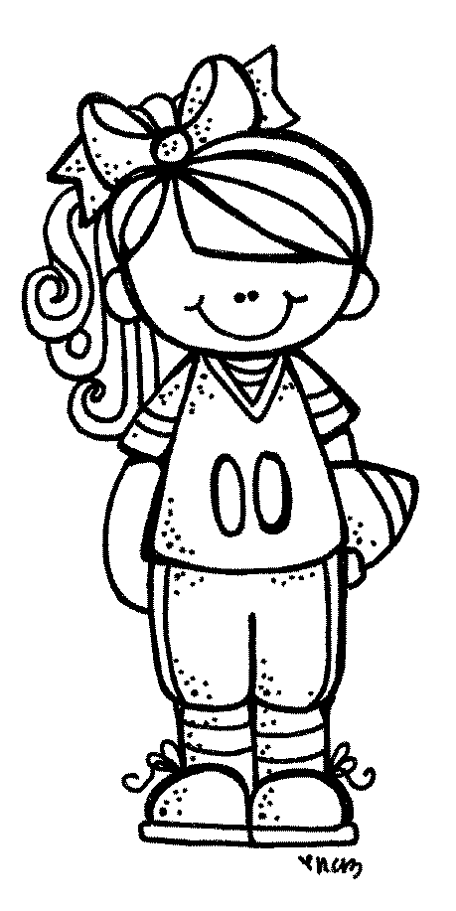
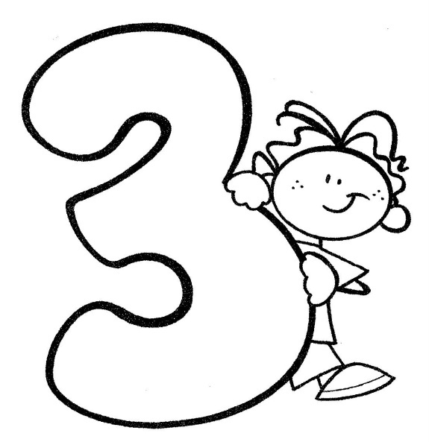
TABLA DE 3
Colorea los múltiplos del 3
3 | X | 1 | = | _____
3 | X | 2 | = | _____
3 | X | 3 | = | _____
3 | X | 4 | = | _____
3 | X | 5 | = | _____
3 | X | 6 | = | _____
3 | X | 7 | = | _____
3 | X | 8 | = | _____
3 | X | 9 | = | _____
3 | X | 10 | = | _____
3 | 17 | 13 | 37 | 49 | 31
6 | 9 | 34 | 13 | 46 | 25
49 | 12 | 15 | 10 | 29 | 23
1 | 2 | 5 | 18 | 21 | 24
3
11 | 17 | 41 | 13 | 27 | 30
Completa la rueda
3 | X | 2 | = | _____
3 | X | 4 | = | _____
3 | X | 3 | = | _____
3 | X | 5 | = | _____
3 | X | 6 | = | _____
3 | X | 7 | = | _____
3 | X | 9 | = | _____
3 | X | 8 | = | _____
3 | X | 1 | = | _____
3 | X | 10 | = | _____
3
9
2
3x
24
3
7
6
5
12
Completa la secuencia de los múltiplos del 3
0 |  | 3 |  |  |  |  |  |  |  |  |  |  |  |  |  |  |  | 27
Proyecto Colaborativo TabliLocas

Slide 9
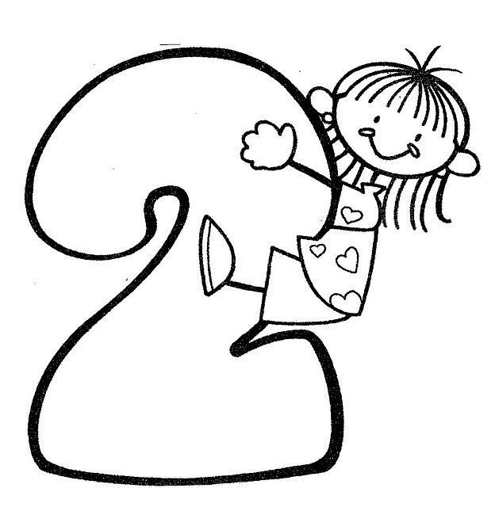

TABLA DE 2
Colorea los múltiplos del 2
2 | X | 1 | = | _____
2 | X | 2 | = | _____
2 | X | 3 | = | _____
2 | X | 4 | = | _____
2 | X | 5 | = | _____
2 | X | 6 | = | _____
2 | X | 7 | = | _____
2 | X | 8 | = | _____
2 | X | 9 | = | _____
2 | X | 10 | = | _____
2 | 17 | 21 | 39 | 21 | 31
4 | 19 | 3 | 33 | 15 | 25
5 | 6 | 8 | 10 | 29 | 23
1 | 27 | 55 | 12 | 14 | 16
11 | 17 | 41 | 13 | 18 | 20
Completa la rueda
2 | X | 2 | = | _____
2 | X | 4 | = | _____
2 | X | 3 | = | _____
2 | X | 5 | = | _____
2 | X | 6 | = | _____
2 | X | 7 | = | _____
2 | X | 9 | = | _____
2 | X | 8 | = | _____
2 | X | 1 | = | _____
2 | X | 10 | = | _____
2
9
2
2x
16
3
7
6
5
10
Completa la secuencia de los múltiplos del 2
0 |  | 2 |  |  |  |  |  |  |  |  |  |  |  |  |  |  |  |  |  | 20
Proyecto Colaborativo TabliLocas

Slide 10


TABLA DE 1
Colorea los múltiplos del 1
1 | X | 1 | = | _____
1 | X | 2 | = | _____
1 | X | 3 | = | _____
1 | X | 4 | = | _____
1 | X | 5 | = | _____
1 | X | 6 | = | _____
1 | X | 7 | = | _____
1 | X | 8 | = | _____
1 | X | 9 | = | _____
1 | X | 10 | = | _____
2 | 17 | 21 | 39 | 21 | 31
4 | 19 | 3 | 33 | 15 | 25
5 | 6 | 8 | 10 | 29 | 23
1 | 27 | 55 | 12 | 14 | 16
11 | 17 | 41 | 13 | 18 | 20
Completa la rueda
1 | X | 2 | = | _____
1 | X | 4 | = | _____
1 | X | 3 | = | _____
1 | X | 5 | = | _____
1 | X | 6 | = | _____
1 | X | 7 | = | _____
1 | X | 9 | = | _____
1 | X | 8 | = | _____
1 | X | 1 | = | _____
1 | X | 10 | = | _____
2
9
2
1x
8
3
7
6
5
5
Completa la secuencia de los múltiplos del 1
0 |  | 1 |  |  |  |  |  |  |  |  |  |  |  |  |  |  |  |  |  | 10
Proyecto Colaborativo TabliLocas

