Slide 1
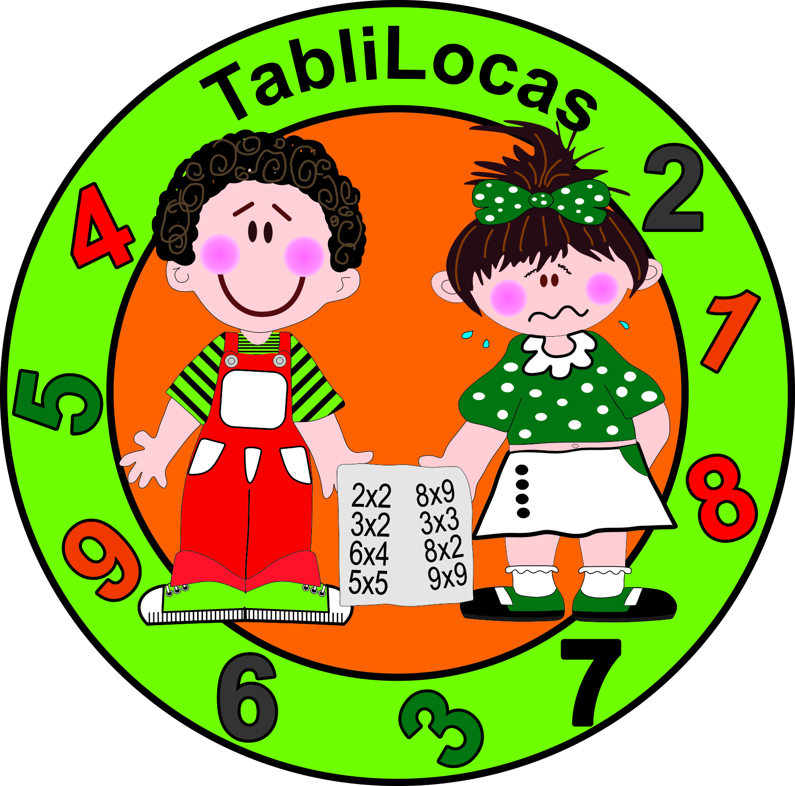
Ejercicio para repasar la serie de la Tabla del 9
Nombre del Alumno__________________________
___ | ___ | ___ | ___ | ___ | ___ | ___ | ___ | ___ | 81 | ___
0 | ___ | ___ | 27 | ___ | ___ | ___ | 63 | ___ | ___ | 90
___ | ___ | 18 | ___ | ___ | 45 | ___ | ___ | ___ | 81 | ___
___ | 9 | ___ | ___ | ___ | ___ | 54 | ___ | ___ | ___ | 90
___ | ___ | ___ | 27 | ___ | ___ | ___ | 63 | ___ | ___ | ___
0 | ___ | 18 | ___ | ___ | ___ | ___ | ___ | ___ | 81 | ___
___ | ___ | ___ | ___ | ___ | 45 | ___ | ___ | ___ | ___ | 90
___ | 9 | ___ | 27 | ___ | ___ | 54 | ___ | ___ | 81 | ___
0 | ___ | 18 | ___ | ___ | ___ | ___ | 63 | ___ | ___ | ___
___ | ___ | ___ | ___ | ___ | ___ | ___ | ___ | ___ | 81 | ___
___ | 9 | 18 | ___ | ___ | 45 | ___ | ___ | ___ | ___ | 90
0 | ___ | ___ | 27 | ___ | ___ | ___ | 63 | ___ | ___ | ___
___ | ___ | ___ | ___ | ___ | ___ | 54 | ___ | ___ | 81 | ___
0 | ___ | ___ | 27 | ___ | ___ | ___ | ___ | ___ | ___ | ___
___ | 9 | 18 | ___ | ___ | ___ | ___ | 63 | ___ | ___ | 90
0 | ___ | ___ | ___ | ___ | 45 | ___ | ___ | ___ | 81 | ___
0 | ___ | 18 | ___ | 36 | ___ | ___ | 63 | ___ | ___ | 90
___ | 9 | ___ | 27 | ___ | ___ | 54 | ___ | 72 | ___ | ___
0 | ___ | ___ | ___ | ___ | 45 | ___ | ___ | ___ | 81 | ___
90 | ___ | 72 | ___ | 54 | 45 | ___ | 27 | 18 | ___ | 0
___ | 81 | ___ | ___ | ___ | ___ | ___ | ___ | ___ | ___ | ___
90 | ___ | ___ | 63 | ___ | ___ | ___ | 27 | ___ | ___ | 0
___ | 81 | ___ | ___ | ___ | 45 | ___ | ___ | 18 | ___ | ___
90 | ___ | ___ | ___ | 54 | ___ | ___ | ___ | ___ | 9 | ___
___ | ___ | ___ | 63 | ___ | ___ | ___ | 27 | ___ | ___ | ___
___ | 81 | ___ | ___ | ___ | ___ | ___ | ___ | 18 | ___ | 0
90 | ___ | ___ | ___ | ___ | 45 | ___ | ___ | ___ | ___ | ___
___ | 81 | ___ | ___ | 54 | ___ | ___ | 27 | ___ | 9 | ___
___ | ___ | ___ | 63 | ___ | ___ | ___ | ___ | 18 | ___ | 0
___ | 81 | ___ | ___ | ___ | ___ | ___ | ___ | ___ | ___ | ___
90 | ___ | ___ | ___ | ___ | 45 | ___ | ___ | 18 | 9 | ___
___ | ___ | ___ | 63 | ___ | ___ | ___ | 27 | ___ | ___ | 0
___ | 81 | ___ | ___ | 54 | ___ | ___ | ___ | ___ | ___ | ___
___ | ___ | ___ | ___ | ___ | ___ | ___ | 27 | ___ | ___ | 0
90 | ___ | ___ | 63 | ___ | ___ | ___ | ___ | 18 | 9 | ___
___ | 81 | ___ | ___ | ___ | 45 | ___ | ___ | ___ | ___ | 0
90 | ___ | ___ | 63 | ___ | ___ | 36 | ___ | 18 | ___ | 0
___ | ___ | 72 | ___ | 54 | ___ | ___ | 27 | ___ | 9 | ___
___ | 81 | ___ | ___ | ___ | 45 | ___ | ___ | ___ | ___ | 0

Slide 2
Ejercicio para repasar la serie de la Tabla del 8
Nombre del Alumno__________________________
___ | 8 | ___ | ___ | 32 | ___ | ___ | ___ | 64 | 72 | ___
0 | ___ | ___ | 24 | ___ | ___ | ___ | 56 | ___ | ___ | 80
___ | ___ | 16 | ___ | ___ | 40 | ___ | ___ | ___ | 72 | ___
___ | 8 | ___ | ___ | ___ | ___ | 48 | ___ | ___ | ___ | 80
___ | ___ | ___ | 24 | ___ | ___ | ___ | 56 | 64 | ___ | ___
0 | ___ | 16 | ___ | ___ | ___ | ___ | ___ | ___ | 72 | ___
___ | ___ | ___ | ___ | ___ | 40 | ___ | ___ | ___ | ___ | 80
___ | 8 | ___ | 24 | ___ | ___ | 48 | ___ | ___ | 72 | ___
0 | ___ | 16 | 24 | ___ | 40 | ___ | 56 | 64 | ___ | ___
___ | ___ | ___ | ___ | ___ | ___ | 48 | ___ | ___ | 72 | ___
___ | 8 | 16 | ___ | ___ | 40 | ___ | ___ | ___ | ___ | 80
0 | ___ | ___ | 24 | ___ | ___ | ___ | 56 | ___ | ___ | ___
___ | ___ | ___ | ___ | ___ | ___ | 48 | ___ | ___ | 72 | ___
0 | ___ | 16 | 24 | ___ | ___ | ___ | ___ | 64 | ___ | ___
___ | 8 | 16 | ___ | ___ | ___ | ___ | 56 | ___ | ___ | 80
0 | ___ | ___ | 24 | ___ | 40 | 48 | ___ | ___ | 72 | ___
0 | ___ | 16 | ___ | 32 | ___ | ___ | 56 | ___ | ___ | 80
___ | 8 | ___ | 24 | ___ | ___ | 48 | ___ | 64 | ___ | ___
0 | ___ | 16 | ___ | ___ | 40 | ___ | 56 | ___ | 72 | ___
80 | ___ | 64 | ___ | 48 | ___ | 32 | 24 | ___ | 8 | 0
___ | 72 | ___ | ___ | ___ | ___ | ___ | ___ | ___ | ___ | ___
80 | ___ | ___ | 56 | ___ | ___ | ___ | 24 | ___ | ___ | 0
___ | 72 | ___ | ___ | ___ | 40 | ___ | ___ | 16 | ___ | ___
80 | ___ | 64 | ___ | 48 | ___ | 32 | ___ | ___ | 8 | ___
___ | ___ | ___ | 56 | ___ | ___ | ___ | 24 | ___ | ___ | ___
___ | 72 | ___ | ___ | ___ | ___ | ___ | ___ | 16 | ___ | 0
80 | ___ | 64 | ___ | ___ | 40 | ___ | ___ | ___ | ___ | ___
___ | 72 | ___ | ___ | 48 | ___ | 32 | 24 | ___ | 8 | ___
___ | ___ | ___ | 56 | ___ | ___ | ___ | ___ | 16 | ___ | 0
___ | 72 | ___ | ___ | ___ | ___ | ___ | ___ | ___ | ___ | ___
80 | ___ | 64 | ___ | ___ | 40 | ___ | ___ | 16 | 8 | ___
___ | ___ | ___ | 56 | ___ | ___ | 32 | 24 | ___ | ___ | 0
___ | 72 | ___ | ___ | 48 | ___ | ___ | ___ | ___ | ___ | ___
___ | ___ | ___ | ___ | ___ | ___ | ___ | 24 | ___ | ___ | 0
80 | ___ | 64 | 56 | ___ | ___ | 32 | ___ | 16 | 8 | ___
___ | 72 | ___ | ___ | ___ | 40 | ___ | ___ | ___ | ___ | 0
80 | ___ | ___ | 56 | ___ | ___ | 32 | ___ | 16 | ___ | 0
___ | ___ | 64 | ___ | 48 | ___ | ___ | 24 | ___ | 8 | ___
___ | 72 | ___ | ___ | ___ | 40 | ___ | ___ | ___ | ___ | 0

Slide 3
Ejercicio para repasar la serie de la Tabla del 7
Ejercicio para repasar la serie de la Tabla del
Nombre del Alumno__________________________
___ | 7 | ___ | ___ | 28 | ___ | ___ | ___ | 56 | 63 | ___
0 | ___ | ___ | 21 | ___ | ___ | ___ | 49 | ___ | ___ | 70
___ | ___ | 14 | ___ | ___ | 35 | ___ | ___ | ___ | 63 | ___
___ | 7 | ___ | ___ | ___ | ___ | 42 | ___ | ___ | ___ | 70
___ | ___ | ___ | 21 | ___ | ___ | ___ | 49 | 56 | ___ | ___
0 | ___ | 14 | ___ | ___ | ___ | ___ | ___ | ___ | 63 | ___
___ | ___ | ___ | ___ | ___ | 35 | ___ | ___ | ___ | ___ | 70
___ | 7 | ___ | 21 | ___ | ___ | 42 | ___ | ___ | 63 | ___
0 | ___ | 14 | 21 | ___ | 35 | ___ | 49 | 56 | ___ | ___
___ | ___ | ___ | ___ | ___ | ___ | 42 | ___ | ___ | 63 | ___
___ | 7 | 14 | ___ | ___ | 35 | ___ | ___ | ___ | ___ | 70
0 | ___ | ___ | 21 | ___ | ___ | ___ | 49 | ___ | ___ | ___
___ | ___ | ___ | ___ | ___ | ___ | 42 | ___ | ___ | 63 | ___
0 | ___ | 14 | 21 | ___ | ___ | ___ | ___ | 56 | ___ | ___
___ | 7 | 14 | ___ | ___ | ___ | ___ | 49 | ___ | ___ | 70
0 | ___ | ___ | 21 | ___ | 35 | 42 | ___ | ___ | 63 | ___
0 | ___ | 14 | ___ | 28 | ___ | ___ | 49 | ___ | ___ | 70
___ | 7 | ___ | 21 | ___ | ___ | 42 | ___ | 56 | ___ | ___
0 | ___ | 14 | ___ | ___ | 35 | ___ | 49 | ___ | 63 | ___
70 | ___ | 56 | 49 | ___ | 35 | 28 | ___ | 14 | ___ | 0
___ | 63 | ___ | ___ | ___ | ___ | ___ | ___ | ___ | ___ | ___
70 | ___ | ___ | 49 | ___ | ___ | ___ | 21 | ___ | ___ | 0
___ | 63 | ___ | ___ | ___ | 35 | ___ | ___ | 14 | ___ | ___
70 | ___ | 56 | ___ | 42 | ___ | 28 | ___ | ___ | 7 | ___
___ | ___ | ___ | 49 | ___ | ___ | ___ | 21 | ___ | ___ | ___
___ | 63 | ___ | ___ | ___ | ___ | ___ | ___ | 14 | ___ | 0
70 | ___ | 56 | ___ | ___ | 35 | ___ | ___ | ___ | ___ | ___
___ | 63 | ___ | ___ | 42 | ___ | 28 | 21 | ___ | 7 | ___
___ | ___ | ___ | 49 | ___ | ___ | ___ | ___ | 14 | ___ | 0
___ | 63 | ___ | ___ | ___ | ___ | ___ | ___ | ___ | ___ | ___
70 | ___ | 56 | ___ | ___ | 35 | ___ | ___ | 14 | 7 | ___
___ | ___ | ___ | 49 | ___ | ___ | 28 | 21 | ___ | ___ | 0
___ | 63 | ___ | ___ | 42 | ___ | ___ | ___ | ___ | ___ | ___
___ | ___ | ___ | ___ | ___ | ___ | ___ | 21 | ___ | ___ | 0
70 | ___ | 56 | 49 | ___ | ___ | 28 | ___ | 14 | 7 | ___
___ | 63 | ___ | ___ | ___ | 35 | ___ | ___ | ___ | ___ | 0
70 | ___ | ___ | 49 | ___ | ___ | 28 | ___ | 14 | ___ | 0
___ | ___ | 56 | ___ | 42 | ___ | ___ | 21 | ___ | 7 | ___
___ | 63 | ___ | ___ | ___ | 35 | ___ | ___ | ___ | ___ | 0

Slide 4
Ejercicio para repasar la serie de la Tabla del 6
Ejercicio para repasar la serie de la Tabla del 6
Nombre del Alumno__________________________
___ | 6 | ___ | ___ | 24 | ___ | ___ | ___ | 48 | 54 | ___
0 | ___ | ___ | 18 | ___ | ___ | ___ | 42 | ___ | ___ | 60
___ | ___ | 12 | ___ | ___ | 30 | ___ | ___ | ___ | 54 | ___
___ | 6 | ___ | ___ | ___ | ___ | 36 | ___ | ___ | ___ | 60
___ | ___ | ___ | 18 | ___ | ___ | ___ | 42 | 48 | ___ | ___
0 | ___ | 12 | ___ | ___ | ___ | ___ | ___ | ___ | 54 | ___
___ | ___ | ___ | ___ | ___ | 30 | ___ | ___ | ___ | ___ | 60
___ | 6 | ___ | 18 | ___ | ___ | 36 | ___ | ___ | 54 | ___
0 | ___ | 12 | 18 | ___ | 30 | ___ | 42 | 48 | ___ | ___
___ | ___ | ___ | ___ | ___ | ___ | 36 | ___ | ___ | 54 | ___
___ | 6 | 12 | ___ | ___ | 30 | ___ | ___ | ___ | ___ | 60
0 | ___ | ___ | 18 | ___ | ___ | ___ | 42 | ___ | ___ | ___
___ | ___ | ___ | ___ | ___ | ___ | 36 | ___ | ___ | 54 | ___
0 | ___ | 12 | 18 | ___ | ___ | ___ | ___ | 48 | ___ | ___
___ | 6 | 12 | ___ | ___ | ___ | ___ | 42 | ___ | ___ | 60
0 | ___ | ___ | 18 | ___ | 30 | 36 | ___ | ___ | 54 | ___
0 | ___ | 12 | ___ | 24 | ___ | ___ | 42 | ___ | ___ | 60
___ | 6 | ___ | 18 | ___ | ___ | 36 | ___ | 48 | ___ | ___
0 | ___ | 12 | ___ | ___ | 30 | ___ | 42 | ___ | 54 | ___
60 | ___ | 48 | 42 | ___ | 30 | ___ | 18 | ___ | 6 | 0
___ | 54 | ___ | ___ | ___ | ___ | ___ | ___ | ___ | ___ | ___
60 | ___ | ___ | 42 | ___ | ___ | ___ | 18 | ___ | ___ | 0
___ | 54 | ___ | ___ | ___ | 30 | ___ | ___ | 12 | ___ | ___
60 | ___ | 48 | ___ | 36 | ___ | 24 | ___ | ___ | 6 | ___
___ | ___ | ___ | 42 | ___ | ___ | ___ | 18 | ___ | ___ | ___
___ | 54 | ___ | ___ | ___ | ___ | ___ | ___ | 12 | ___ | 0
60 | ___ | 48 | ___ | ___ | 30 | ___ | ___ | ___ | ___ | ___
___ | 54 | ___ | ___ | 36 | ___ | 24 | 18 | ___ | 6 | ___
___ | ___ | ___ | 42 | ___ | ___ | ___ | ___ | 12 | ___ | 0
___ | 54 | ___ | ___ | ___ | ___ | ___ | ___ | ___ | ___ | ___
60 | ___ | 48 | ___ | ___ | 30 | ___ | ___ | 12 | 6 | ___
___ | ___ | ___ | 42 | ___ | ___ | 24 | 18 | ___ | ___ | 0
___ | 54 | ___ | ___ | 36 | ___ | ___ | ___ | ___ | ___ | ___
___ | ___ | ___ | ___ | ___ | ___ | ___ | 18 | ___ | ___ | 0
60 | ___ | 48 | 42 | ___ | ___ | 24 | ___ | 12 | 6 | ___
___ | 54 | ___ | ___ | ___ | 30 | ___ | ___ | ___ | ___ | 0
60 | ___ | ___ | 42 | ___ | ___ | 24 | ___ | 12 | ___ | 0
___ | ___ | 48 | ___ | 36 | ___ | ___ | 18 | ___ | 6 | ___
___ | 54 | ___ | ___ | ___ | 30 | ___ | ___ | ___ | ___ | 0

Slide 5
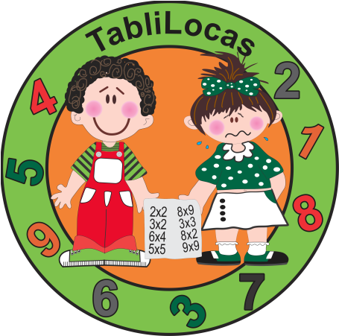
Ejercicio para repasar la serie de la Tabla del 5
Ejercicio para repasar la serie de la Tabla del 5
Nombre del Alumno__________________________
___ | 5 | ___ | ___ | 20 | ___ | ___ | ___ | 40 | 45 | ___
0 | ___ | ___ | 15 | ___ | ___ | ___ | 35 | ___ | ___ | 50
___ | ___ | 10 | ___ | ___ | 25 | ___ | ___ | ___ | 45 | ___
___ | 5 | ___ | ___ | 20 | ___ | 30 | ___ | ___ | ___ | 50
___ | ___ | ___ | 15 | ___ | ___ | ___ | 35 | 40 | ___ | ___
0 | ___ | 10 | ___ | ___ | ___ | ___ | ___ | ___ | 45 | ___
___ | ___ | ___ | ___ | 20 | 25 | ___ | ___ | ___ | ___ | 50
___ | 5 | ___ | 15 | ___ | ___ | 30 | ___ | ___ | 45 | ___
0 | ___ | 10 | 15 | ___ | 25 | ___ | 35 | 40 | ___ | ___
___ | ___ | ___ | ___ | ___ | ___ | 30 | ___ | ___ | 45 | ___
___ | 5 | 10 | ___ | ___ | 25 | ___ | ___ | ___ | ___ | 50
0 | ___ | ___ | 15 | 20 | ___ | ___ | 35 | ___ | ___ | ___
___ | ___ | ___ | ___ | ___ | ___ | 30 | ___ | ___ | 45 | ___
0 | ___ | 10 | 15 | 20 | ___ | ___ | ___ | 40 | ___ | ___
___ | 5 | 10 | ___ | ___ | ___ | ___ | 35 | ___ | ___ | 50
0 | ___ | ___ | 15 | ___ | 25 | 30 | ___ | ___ | 45 | ___
0 | ___ | 10 | ___ | 20 | ___ | ___ | 35 | ___ | ___ | 50
___ | 5 | ___ | 15 | ___ | ___ | 30 | ___ | 40 | ___ | ___
0 | ___ | 10 | ___ | ___ | 25 | ___ | 35 | ___ | 45 | ___
50 | ___ | 40 | 35 | ___ | 25 | ___ | 15 | ___ | 5 | 0
___ | 45 | ___ | ___ | ___ | ___ | ___ | ___ | ___ | ___ | ___
50 | ___ | ___ | 35 | ___ | ___ | ___ | 15 | ___ | ___ | 0
___ | 45 | ___ | ___ | ___ | 25 | ___ | ___ | 10 | ___ | ___
50 | ___ | 40 | ___ | 30 | ___ | 20 | ___ | ___ | 5 | ___
___ | ___ | ___ | 35 | ___ | ___ | ___ | 15 | ___ | ___ | ___
___ | 45 | ___ | ___ | ___ | ___ | ___ | ___ | 10 | ___ | 0
50 | ___ | 40 | ___ | ___ | 25 | ___ | ___ | ___ | ___ | ___
___ | 45 | ___ | ___ | 30 | ___ | 20 | 15 | ___ | 5 | ___
___ | ___ | ___ | 35 | ___ | ___ | ___ | ___ | 10 | ___ | 0
___ | 45 | ___ | ___ | ___ | ___ | ___ | ___ | ___ | ___ | ___
50 | ___ | 40 | ___ | ___ | 25 | ___ | ___ | 10 | 5 | ___
___ | ___ | ___ | 35 | ___ | ___ | 20 | 15 | ___ | ___ | 0
___ | 45 | ___ | ___ | 30 | ___ | ___ | ___ | ___ | ___ | ___
___ | ___ | ___ | ___ | ___ | ___ | ___ | 15 | ___ | ___ | 0
50 | ___ | 40 | 35 | ___ | ___ | 20 | ___ | 10 | 5 | ___
___ | 45 | ___ | ___ | ___ | 25 | ___ | ___ | ___ | ___ | 0
50 | ___ | ___ | 35 | ___ | ___ | 20 | ___ | 10 | ___ | 0
___ | ___ | 40 | ___ | 30 | ___ | ___ | 15 | ___ | 5 | ___
___ | 45 | ___ | ___ | ___ | 25 | ___ | ___ | ___ | ___ | 0

Slide 6
Ejercicio para repasar la serie de la Tabla del 4
Ejercicio para repasar la serie de la Tabla del
Nombre del Alumno__________________________
___ | 4 | ___ | ___ | 16 | ___ | ___ | ___ | 32 | 36 | ___
0 | ___ | ___ | 12 | ___ | ___ | ___ | 28 | ___ | ___ | 40
___ | ___ | 8 | ___ | ___ | 20 | ___ | ___ | ___ | 36 | ___
___ | 4 | ___ | ___ | 16 | ___ | 24 | ___ | ___ | ___ | 40
___ | ___ | ___ | 12 | ___ | ___ | ___ | 28 | 32 | ___ | ___
0 | ___ | 8 | ___ | ___ | ___ | ___ | ___ | ___ | 36 | ___
___ | ___ | ___ | ___ | 16 | 20 | ___ | ___ | ___ | ___ | 40
___ | 4 | ___ | 12 | ___ | ___ | 24 | ___ | ___ | 36 | ___
0 | ___ | 8 | 12 | ___ | 20 | ___ | 28 | 32 | ___ | ___
___ | ___ | ___ | ___ | ___ | ___ | 24 | ___ | ___ | 36 | ___
___ | 4 | 8 | ___ | ___ | 20 | ___ | ___ | ___ | ___ | 40
0 | ___ | ___ | 12 | 16 | ___ | ___ | 28 | ___ | ___ | ___
___ | ___ | ___ | ___ | ___ | ___ | 24 | ___ | ___ | 36 | ___
0 | ___ | 8 | 12 | 16 | ___ | ___ | ___ | 32 | ___ | ___
___ | 4 | 8 | ___ | ___ | ___ | ___ | 28 | ___ | ___ | 40
0 | ___ | ___ | 12 | ___ | 20 | 24 | ___ | ___ | 36 | ___
0 | ___ | 8 | ___ | 16 | ___ | ___ | 28 | ___ | ___ | 40
___ | 4 | ___ | 12 | ___ | ___ | 24 | ___ | 32 | ___ | ___
0 | ___ | 8 | ___ | ___ | 20 | ___ | 28 | ___ | 36 | ___
40 | ___ | 32 | 28 | ___ | 20 | ___ | 12 | ___ | 4 | 0
___ | 36 | ___ | ___ | ___ | ___ | ___ | ___ | ___ | ___ | ___
40 | ___ | ___ | 28 | ___ | ___ | ___ | 12 | ___ | ___ | 0
___ | 36 | ___ | ___ | ___ | 20 | ___ | ___ | 8 | ___ | ___
40 | ___ | 32 | ___ | 24 | ___ | 16 | ___ | ___ | 4 | ___
___ | ___ | ___ | 28 | ___ | ___ | ___ | 12 | ___ | ___ | ___
___ | 36 | ___ | ___ | ___ | ___ | ___ | ___ | 8 | ___ | 0
40 | ___ | 32 | ___ | ___ | 20 | ___ | ___ | ___ | ___ | ___
___ | 36 | ___ | ___ | 24 | ___ | 16 | 12 | ___ | 4 | ___
___ | ___ | ___ | 28 | ___ | ___ | ___ | ___ | 8 | ___ | 0
___ | 36 | ___ | ___ | ___ | ___ | ___ | ___ | ___ | ___ | ___
40 | ___ | 32 | ___ | ___ | 20 | ___ | ___ | 8 | 4 | ___
___ | ___ | ___ | 28 | ___ | ___ | 16 | 12 | ___ | ___ | 0
___ | 36 | ___ | ___ | 24 | ___ | ___ | ___ | ___ | ___ | ___
___ | ___ | ___ | ___ | ___ | ___ | ___ | 12 | ___ | ___ | 0
40 | ___ | 32 | 28 | ___ | ___ | 16 | ___ | 8 | 4 | ___
___ | 36 | ___ | ___ | ___ | 20 | ___ | ___ | ___ | ___ | 0
40 | ___ | ___ | 28 | ___ | ___ | 16 | ___ | 8 | ___ | 0
___ | ___ | 32 | ___ | 24 | ___ | ___ | 12 | ___ | 4 | ___
___ | 36 | ___ | ___ | ___ | 20 | ___ | ___ | ___ | ___ | 0

Slide 7
Ejercicio para repasar la serie de la Tabla del 3
Ejercicio para repasar la serie de la Tabla del
Nombre del Alumno__________________________
___ | 3 | ___ | ___ | 12 | ___ | ___ | ___ | 24 | 27 | ___
0 | ___ | ___ | 9 | ___ | ___ | ___ | 21 | ___ | ___ | 30
___ | ___ | 6 | ___ | ___ | 15 | ___ | ___ | ___ | 27 | ___
___ | 3 | ___ | ___ | 12 | ___ | 18 | ___ | ___ | ___ | 30
___ | ___ | ___ | 9 | ___ | ___ | ___ | 21 | 24 | ___ | ___
0 | ___ | 6 | ___ | ___ | ___ | ___ | ___ | ___ | 27 | ___
___ | ___ | ___ | ___ | 12 | 15 | ___ | ___ | ___ | ___ | 30
___ | 3 | ___ | 9 | ___ | ___ | 18 | ___ | 24 | 27 | ___
0 | ___ | 6 | 9 | ___ | 15 | ___ | 21 | 24 | ___ | ___
___ | ___ | ___ | ___ | ___ | ___ | 18 | ___ | ___ | 27 | ___
___ | 3 | 6 | ___ | ___ | 15 | ___ | ___ | ___ | ___ | 30
0 | ___ | ___ | 9 | 12 | ___ | ___ | 21 | ___ | ___ | ___
___ | ___ | ___ | ___ | ___ | ___ | 18 | ___ | ___ | 27 | ___
0 | ___ | 6 | 9 | 12 | ___ | ___ | ___ | 24 | ___ | ___
___ | 3 | 6 | ___ | ___ | ___ | ___ | 21 | ___ | ___ | 30
0 | ___ | ___ | 9 | ___ | 15 | 18 | ___ | ___ | 27 | ___
0 | ___ | 6 | ___ | 12 | ___ | ___ | 21 | ___ | ___ | 30
___ | 3 | ___ | 9 | ___ | ___ | 18 | ___ | 24 | ___ | ___
0 | ___ | 6 | ___ | ___ | 15 | ___ | 21 | ___ | 27 | ___
30 | ___ | 24 | 21 | ___ | 15 | ___ | 9 | ___ | 3 | 0
___ | 27 | ___ | ___ | ___ | ___ | ___ | ___ | ___ | ___ | ___
30 | ___ | ___ | 21 | ___ | ___ | ___ | 9 | ___ | ___ | 0
___ | 27 | ___ | ___ | ___ | 15 | ___ | ___ | 6 | ___ | ___
30 | ___ | 24 | ___ | 18 | ___ | 12 | ___ | ___ | 3 | ___
___ | ___ | ___ | 21 | ___ | ___ | ___ | 9 | ___ | ___ | ___
___ | 27 | ___ | ___ | ___ | ___ | ___ | ___ | 6 | ___ | 0
30 | ___ | 24 | ___ | ___ | 15 | ___ | ___ | ___ | ___ | ___
___ | 27 | ___ | ___ | 18 | ___ | 12 | 9 | ___ | 3 | ___
___ | ___ | ___ | 21 | ___ | ___ | ___ | ___ | 6 | ___ | 0
___ | 27 | ___ | ___ | ___ | ___ | ___ | ___ | ___ | ___ | ___
30 | ___ | 24 | ___ | ___ | 15 | ___ | ___ | 6 | 3 | ___
___ | ___ | ___ | 21 | ___ | ___ | 12 | 9 | ___ | ___ | 0
___ | 27 | ___ | ___ | 18 | ___ | ___ | ___ | ___ | ___ | ___
___ | ___ | ___ | ___ | ___ | ___ | ___ | 9 | ___ | ___ | 0
30 | ___ | 24 | 21 | ___ | ___ | 12 | ___ | 6 | 3 | ___
___ | 27 | ___ | ___ | ___ | 15 | ___ | ___ | ___ | ___ | 0
30 | ___ | ___ | 21 | ___ | ___ | 12 | ___ | 6 | ___ | 0
___ | ___ | 24 | ___ | 18 | ___ | ___ | 9 | ___ | 3 | ___
___ | 27 | ___ | ___ | ___ | 15 | ___ | ___ | ___ | ___ | 0

Slide 8
Ejercicio para repasar la serie de la Tabla del 2
Ejercicio para repasar la serie de la Tabla del
Nombre del Alumno__________________________
___ | 2 | ___ | ___ | 8 | ___ | ___ | ___ | 16 | 18 | ___
0 | ___ | ___ | 6 | ___ | ___ | ___ | 14 | ___ | ___ | 20
___ | ___ | 4 | ___ | ___ | 10 | ___ | ___ | ___ | 18 | ___
___ | 2 | ___ | ___ | 8 | ___ | 12 | ___ | ___ | ___ | 20
___ | ___ | ___ | 6 | ___ | ___ | ___ | 14 | 16 | ___ | ___
0 | ___ | 4 | ___ | ___ | ___ | ___ | ___ | ___ | 18 | ___
___ | ___ | ___ | ___ | 8 | 10 | ___ | ___ | ___ | ___ | 20
___ | 2 | ___ | 6 | ___ | ___ | 12 | ___ | 16 | 18 | ___
0 | ___ | 4 | 6 | ___ | 10 | ___ | 14 | 16 | ___ | ___
___ | ___ | ___ | ___ | ___ | ___ | 12 | ___ | ___ | 18 | ___
___ | 2 | 4 | ___ | ___ | 10 | ___ | ___ | ___ | ___ | 20
0 | ___ | ___ | 6 | 8 | ___ | ___ | 14 | ___ | ___ | ___
___ | ___ | ___ | ___ | ___ | ___ | 12 | ___ | ___ | 18 | ___
0 | ___ | 4 | 6 | 8 | ___ | ___ | ___ | 16 | ___ | ___
___ | 2 | 4 | ___ | ___ | ___ | ___ | 14 | ___ | ___ | 20
0 | ___ | ___ | 6 | ___ | 10 | 12 | ___ | ___ | 18 | ___
0 | ___ | 4 | ___ | 8 | ___ | ___ | 14 | ___ | ___ | 20
___ | 2 | ___ | 6 | ___ | ___ | 12 | ___ | 16 | ___ | ___
0 | ___ | 4 | ___ | ___ | 10 | ___ | 14 | ___ | 18 | ___
20 | ___ | 16 | 14 | ___ | 10 | ___ | 6 | ___ | 2 | 0
___ | 18 | ___ | ___ | ___ | ___ | ___ | ___ | ___ | ___ | ___
20 | ___ | ___ | 14 | ___ | ___ | ___ | 6 | ___ | ___ | 0
___ | 18 | ___ | ___ | ___ | 10 | ___ | ___ | 4 | ___ | ___
20 | ___ | 16 | ___ | 12 | ___ | 8 | ___ | ___ | 2 | ___
___ | ___ | ___ | 14 | ___ | ___ | ___ | 6 | ___ | ___ | ___
___ | 18 | ___ | ___ | ___ | ___ | ___ | ___ | 4 | ___ | 0
20 | ___ | 16 | ___ | ___ | 10 | ___ | ___ | ___ | ___ | ___
___ | 18 | ___ | ___ | 12 | ___ | 8 | 6 | ___ | 2 | ___
___ | ___ | ___ | 14 | ___ | ___ | ___ | ___ | 4 | ___ | 0
___ | 18 | ___ | ___ | ___ | ___ | ___ | ___ | ___ | ___ | ___
20 | ___ | 16 | ___ | ___ | 10 | ___ | ___ | 4 | 2 | ___
___ | ___ | ___ | 14 | ___ | ___ | 8 | 6 | ___ | ___ | 0
___ | 18 | ___ | ___ | 12 | ___ | ___ | ___ | ___ | ___ | ___
___ | ___ | ___ | ___ | ___ | ___ | ___ | 6 | ___ | ___ | 0
20 | ___ | 16 | 14 | ___ | ___ | 8 | ___ | 4 | 2 | ___
___ | 18 | ___ | ___ | ___ | 10 | ___ | ___ | ___ | ___ | 0
20 | ___ | ___ | 14 | ___ | ___ | 8 | ___ | 4 | ___ | 0
___ | ___ | 16 | ___ | 12 | ___ | ___ | 6 | ___ | 2 | ___
___ | 18 | ___ | ___ | ___ | 10 | ___ | ___ | ___ | ___ | 0

Slide 9
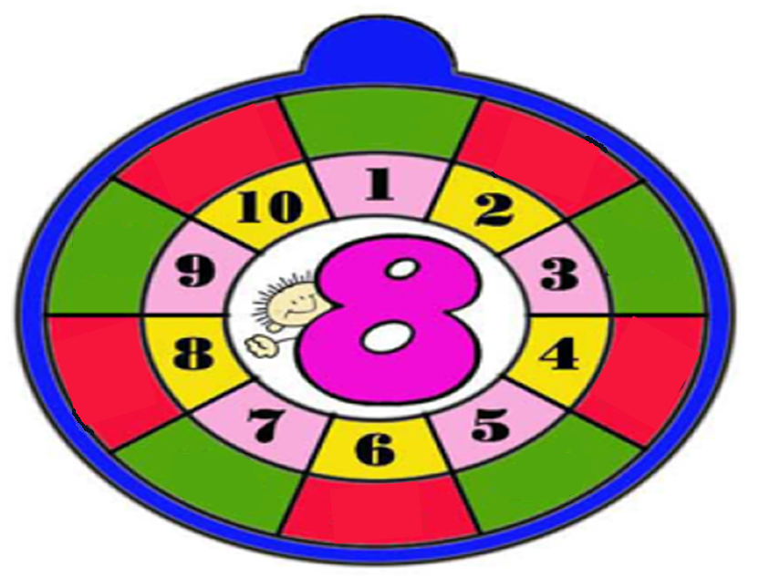
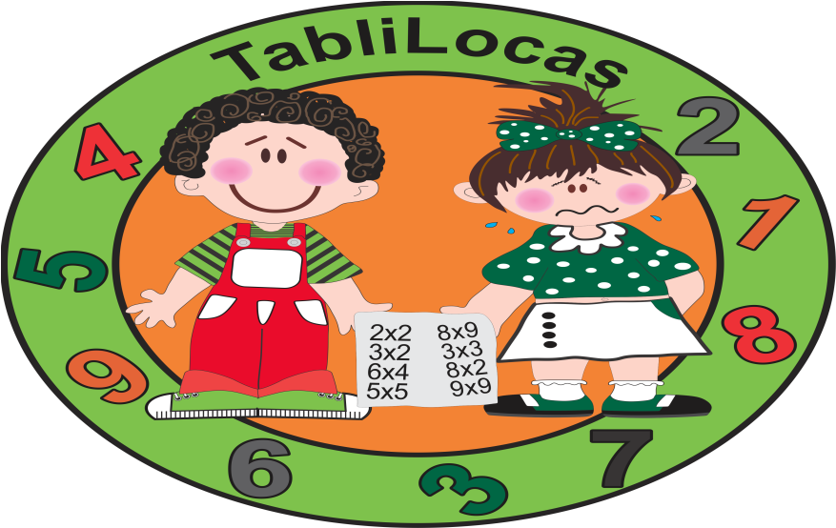
Rueda de Multiplicar para practicar la Tabla del 9
9

Slide 10
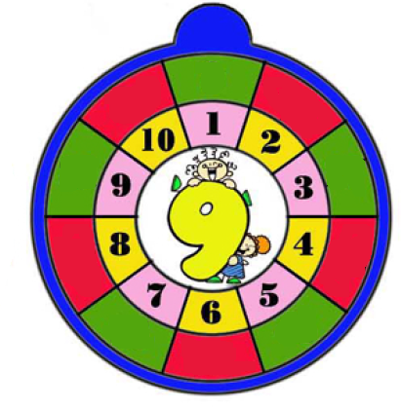
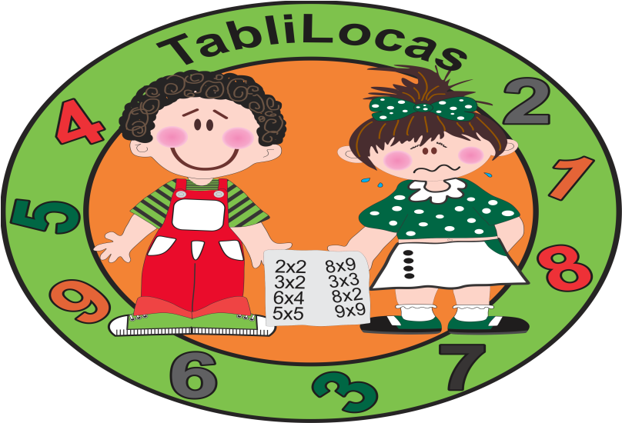
Rueda de Multiplicar para practicar la Tabla del 8
8

Slide 11
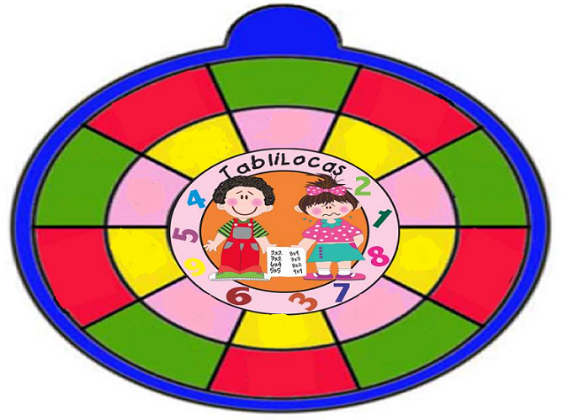

Rueda de Multiplicar para practicar todas las Tablas

Slide 12
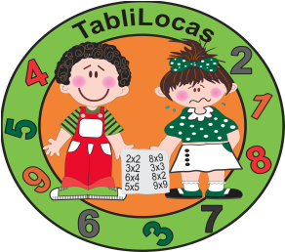

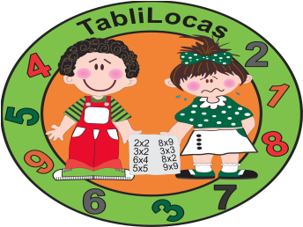
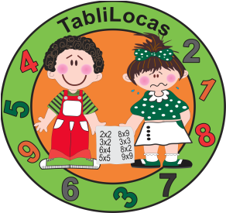
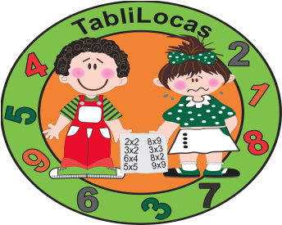
Ruedas de Multiplicar para practicar todas las Tablas
6
5
8
10
0
7
10
0
7
2
__
1
1
2
1
2
3
4
3
4
3
4
7
10
8
6
8
6
0
5
5
1
0
8
10
4
9
2
3
7
4
3
5
3
6
10
9
5
6
8
0
8
2
6
1
2
4
1
7
7
5

Slide 13
MATELOCALOTERIA
TABLA DE MULTIPLICAR
5

Slide 14
5 x 1
10
5 x 7
45
5 x 0
30
5 x 4
50
5 x 3
L O T E R I A

Slide 15
5 x 8
5 x 2
5 x 5
35
0
20
5 x 10
5 x 6
5 x 9
L O T E R I A

Slide 16
5 x 1
15
5 x 9
35
10
5 x 5
20
5 x 10
5 x 8
L O T E R I A

Slide 17
5 x 7
40
5 x 6
45
5 x 3
5
5 x 2
50
5 x 4
L O T E R I A

Slide 18
45
5 x 5
5
10
5 x 7
20
30
5 x 0
50
L O T E R I A

Slide 19
L O T E R I A

Slide 20
5 x 1
5 x 2
5 x 3
5 x 4
5 x 5
5 x 6
5 x 7
5 x 8

Slide 21
5 x 9
5
10
5 x 10
15
20
25
30

Slide 22
35
40
45
50
5 x 0
0

Slide 23
MATELOCALOTERIA
TABLA DE MULTIPLICAR
4

Slide 24
12
4 x 10
16
4 x 9
4 x 6
4 x 8
28
4 x 5
8
L O T E R I A

Slide 25
32
4 x 5
4
28
4 x 3
36
4 x 0
8
16
L O T E R I A

Slide 26
4 x 3
20
4 x 8
36
4 x 1
24
4 x 2
40
4 x 4
L O T E R I A

Slide 27
12
0
4 x 10
28
4 x 9
16
36
4 x 7
20
L O T E R I A

Slide 28
4 x 0
4 x 6
20
4 x 1
8
4 x 10
28
4 x 3
36
L O T E R I A

Slide 29
L O T E R I A

Slide 30
4 x 1
4 x 2
4 x 3
4 x 4
4 x 5
4 x 6
4 x 7
4 x 8

Slide 31
4 x 9
4
8
4 x 10
12
16
20
24

Slide 32
28
32
36
40
4 x 0
0

Slide 33
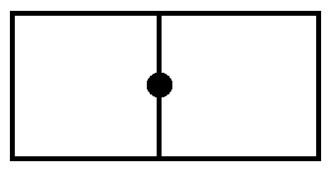
Matedomiloco para jugar con la Tabla de Multiplicar del 2
0
2 x 6
4
2 x 8
18
2 0
6
2 x 4
2 x 5
2 x 3
1 2
2 x 2
8
2 x 1
2 x 10
1 0
1 6
2 x 9
2
2 x 7
14
2 x 0

Slide 34
Matedomiloco para jugar con la Tabla de Multiplicar del 3
0
3 x 6
6
3 x 8
2 7
3 0
9
3 x 4
3 x 5
3 x 3
1 8
3 x 2
1 2
3 x 1
3 x 1 0
1 5
2 4
3 x 9
3
3 x 7
21
3 x 0

Slide 35
Matedomiloco para jugar con las
Tablas de Multiplicar

Slide 36
0
2 x 6
1 2
3 x 9
5 x 3
6 x 4
2 7
1 5
7 x 3
4 x 4
2 x 9
2 7
2 4
2 1
8 1
1 8
3 x 9
4 x 9
1 6
9 x 9
3 0
4 8
3 6
5 x 6

Slide 37
6 x 8
1 4
5 x 5
4 0
9 x 6
7 x 7
2 x 7
4 x 2
5 x 2
3 0
8 x 5
5 4
4 9
6 x 1
2 8
8 x 4
3 2
9 x 0
6 x 5
7 x 4
6
10
8
2 5

Slide 38
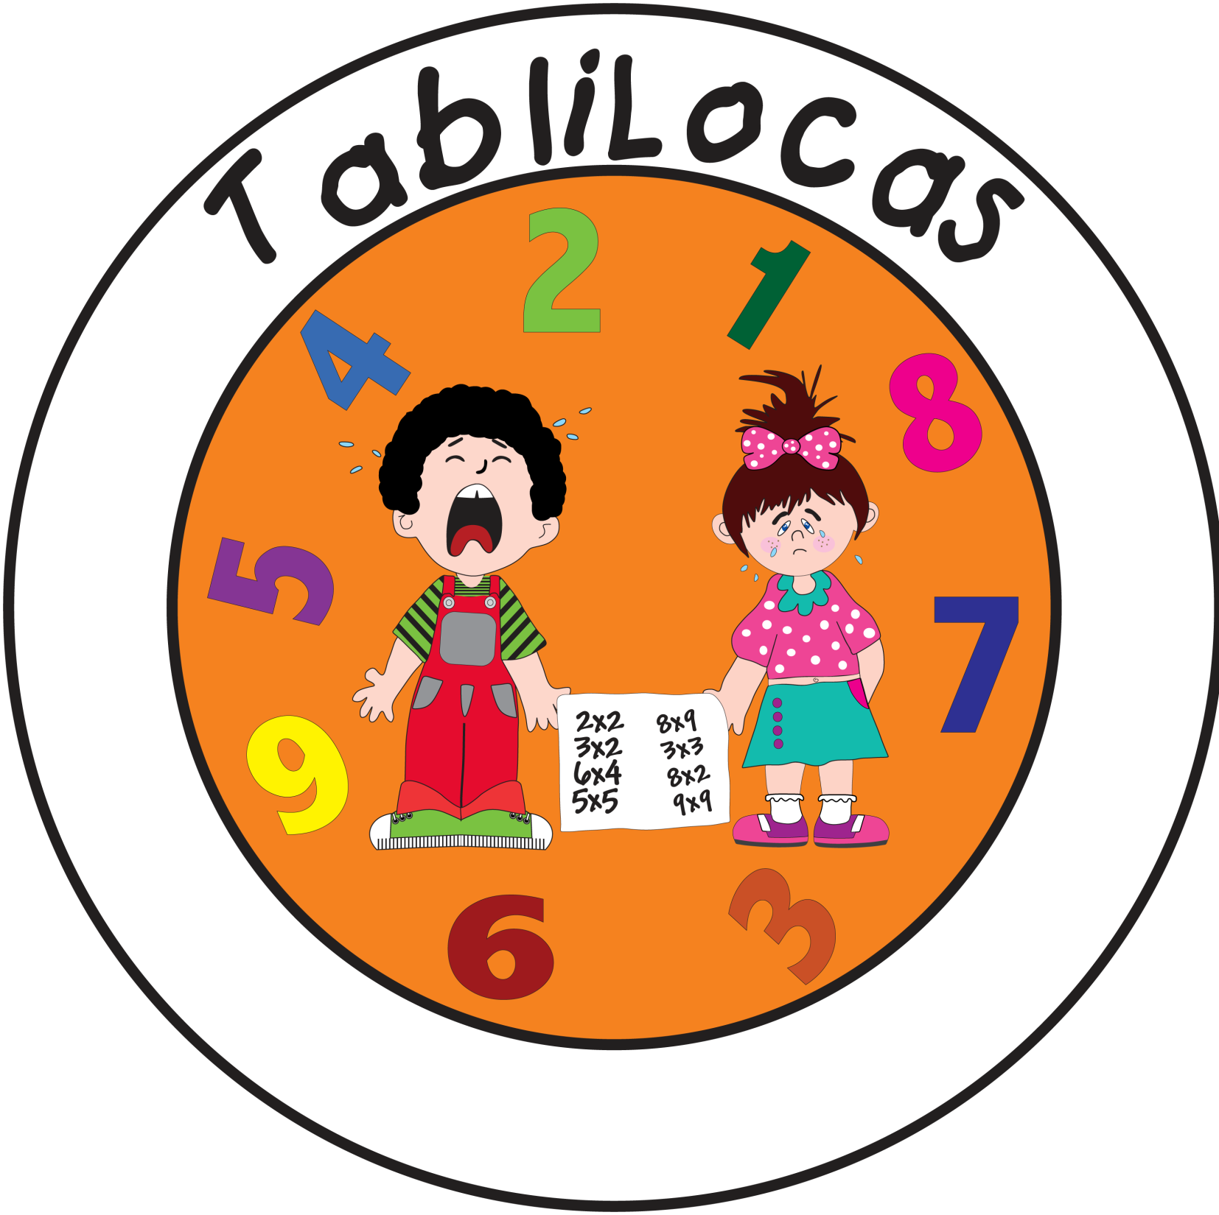
TabliLoca del 9
ROJO
9 x 0 = ____
9 x 1= ____
9 x 2= ____
AZUL
9 x 3 = ____
9 x 4= ____
9 x 5= ____
VERDE
9 x 6 = ____
9 x 7= ____
9 x 8= ____
ROSA
9 x 9= ____
9 x 10= ____
0
18
72
90
27
63
45
36
81
54
9

Slide 39
TabliLoca del 8
ROJO
8 x 0 = ____
8 x 1= ____
8 x 2= ____
AZUL
8 x 3 = ____
8 x 4= ____
8 x 5= ____
VERDE
8 x 6 = ____
8 x 7= ____
8 x 8= ____
ROSA
8 x 9= ____
8 x 10= ____
8
0
24
32
56
48
64
40
72
80
16

Slide 40
TabliLoca del __
ROJO
__ x 0 = ____
__ x 1= ____
__x 2= ____
AZUL
__x 3 = ____
__ x 4= ____
__ x 5= ____
VERDE
__ x 6 = ____
__ x 7= ____
__ x 8= ____
ROSA
__ x 9= ____
__ x 10= ____

Slide 41

9 x 0 = ____NARANJA
9 x 1= ____
9 x 2= ____
9 x 3 = ____
9 x 4= ____
9 x 5= ____ROSA
9 x 6 = ____
9 x 7= ____
9 x 8= ____
9 x 9= ____VERDE
9 x 10= ____
8 x 0 = ____ NARANJA
8 x 1= ____
8 x 2= ____ROSA
8 x 3 = ____CAFE
8 x 4= ____ ROJO
8 x 5= ____
8 x 6 = ____AZUL
8 x 7= ____VERDE
8 x 8= ____MORADO
8 x 9= ____
8 x 10= ____
7 x 0 = ____ NARANJA
7 x 1= ____
7 x 2= ____
7 x 3 = ____
7 x 4= ____ ROSA
9 x 5= ____
7 x 6 = ____ ROJO
7 x 7= ____
7 x 8= ____VERDE
7 x 9= ____
7 x 10= ____
3 x 0 = ____ NARANJA 3 x 1= ____ 3 x 2= ____ 3 x 3 = ____3 x 4= ____VERDE
3 x 5= ____ 3 x 6 = ____ 3 x 7= ____3 x 8= ____CAFE
3 x 9= ____ 3 x 10= ____VERDE
6 x 0 = ____ NARANJA
6 x 1= ____
6 x 2= ____VERDE
6 x 3 = ____
6 x 4= ____CAFE
6 x 5= ____VERDE
6 x 6 = ____
6 x 7= ____ROJO
6 x 8= ____AZUL
6 x 9= ____
6 x 10= ____
5 x 0 = ____ NARANJA
5 x 1= ____
5 x 2= ____
5 x 3 = ____
5 x 4= ____
5 x 5= ____CELESTE
5 x 6 = ____ VERDE
5 x 7= ____
5 x 8= ____
5 x 9= ____ROSA
5 x 10= ____NARANJA
4 x 0 = ____ NARANJA
4 x 1= ____
4 x 2= ____AMARILLO
4 x 3 = ____VERDE
4 x 4= ____ ROSA
4 x 5= ____
4 x 6 = ____ CAFE
4 x 7= ____ ROSA
4 x 8= ____ ROJO
4 x 9= ____
4 x 10= ____
56
25
0
30
64
28
16
16
16
16
81
45
42
8
16
16
12
12
24
48
50
2 x 0 = ____ NARANJA 2 x 1= ____ 2 x 2= ____ 2 x 3 = ____ 2 x 4= ____AMARILLO
2 x 5= ____ 2 x 6 = ____VERDE 2 x 7= ____2 x 8= ____ ROSA
2 x 9= ____ 2 x 10= ____

Slide 42
9 x 0 = ____
9 x 1= ____
9 x 2= ____
9 x 3 = ____
9 x 4= ____
9 x 5= ____
9 x 6 = ____
9 x 7= ____
9 x 8= ____
9 x 9= ____
9 x 10= ____
8 x 0 = ____
8 x 1= ____
8 x 2= ____
8 x 3 = ____
8 x 4= ____
8 x 5= ____
8 x 6 = ____
8 x 7= ____
8 x 8= ____
8 x 9= ____
8 x 10= ____
7 x 0 = ____
7 x 1= ____
7 x 2= ____
7 x 3 = ____
7 x 4= ____
9 x 5= ____
7 x 6 = ____
7 x 7= ____
7 x 8= ____
7 x 9= ____
7 x 10= ____
Ejercicio para repasar las Tablas de Multiplicar
6 x 0 = ____
6 x 1= ____
6 x 2= ____
6 x 3 = ____
6 x 4= ____
6 x 5= ____
6 x 6 = ____
6 x 7= ____
6 x 8= ____
6 x 9= ____
6 x 10= ____
5 x 0 = ____
5 x 1= ____
5 x 2= ____
5 x 3 = ____
5 x 4= ____
5 x 5= ____
5 x 6 = ____
5 x 7= ____
5 x 8= ____
5 x 9= ____
5 x 10= ____
4 x 0 = ____
4 x 1= ____
4 x 2= ____
4 x 3 = ____
4 x 4= ____
4 x 5= ____
4 x 6 = ____
4 x 7= ____
4 x 8= ____
4 x 9= ____
4 x 10= ____
2 x 0 = ____
2 x 1= ____
2 x 2= ____
2 x 3 = ____
2 x 4= ____
2 x 5= ____
2 x 6 = ____
2 x 7= ____
2 x 8= ____
2 x 9= ____
2 x 10= ____
3 x 0 = ____
3 x 1= ____
3 x 2= ____
3 x 3 = ____
3 x 4= ____
3 x 5= ____
3 x 6 = ____
3 x 7= ____
3 x 8= ____
3 x 9= ____
3 x 10= ____

Slide 43
Ejercicio: Encuentra el número perdido
9 | X | 1 | =
8 | X | 10 | =
9 | X |  | = | 90
8 | X | 5 | =
9 | X |  | = | 72
9 | X | 2 | =
8 | X |  | = | 24
8 | X | 8 | =
9 | X |  | = | 36
8 | X | 1 | =
9 | X |  | = | 27
8 | X | 0 | =
9 | X |  | = | 54
8 | X | 6 | =
9 | X |  | = | 63
8 | X | 9 | =
9 | X |  | = | 45
8 | X | 2 | =
9 | X |  | = | 81
 | X | 4 | = | 32
9 | X | 0 | =
 | X | 7 | = | 56
7 | X | 1 | =
6 | X | 10 | =
7 | X |  | = | 70
6 | X | 5 | =
7 | X |  | = | 56
7 | X | 2 | =
6 | X |  | = | 18
6 | X | 8 | =
7 | X |  | = | 28
6 | X | 1 | =
7 | X |  | = | 21
6 | X | 0 | =
7 | X |  | = | 42
6 | X | 6 | =
7 | X |  | = | 49
6 | X | 9 | =
7 | X |  | = | 35
6 | X | 2 | =
7 | X |  | = | 63
 | X | 4 | = | 24
7 | X | 0 | =
 | X | 7 | = | 42
5 | X | 1 | =
4 | X | 10 | =
5 | X |  | = | 50
 | X | 5 | = | 20
5 | X |  | = | 40
5 | X | 2 | =
4 | X |  | = | 12
 | X | 8 | = | 32
5 | X |  | = | 20
4 | X | 1 | =
5 | X |  | = | 15
4 | X | 0 | =
5 | X |  | = | 30
4 | X |  | = | 24
5 | X |  | = | 35
4 | X | 9 | =
5 | X |  | = | 25
 | X | 2 | = | 8
5 | X |  | = | 45
 | X | 4 | = | 16
5 | X | 0 | =
 | X | 7 | = | 28
3 | X | 1 | =
2 | X | 10 | =
3 | X |  | = | 30
 | X | 5 | = | 10
3 | X |  | = | 24
3 | X | 2 | =
2 | X |  | = | 6
 | X | 8 | = | 16
3 | X |  | = | 12
2 | X | 1 | =
3 | X |  | = | 12
2 | X | 0 | =
3 | X |  | = | 18
2 | X |  | = | 12
3 | X |  | = | 21
2 | X | 9 | =
3 | X |  | = | 15
 | X | 2 | = | 4
3 | X |  | = | 27
 | X | 4 | = | 8
3 | X | 0 | =
 | X | 7 | = | 14

Slide 44
Con LocoBarajas aprendo
1
2
3
4
5
6
7
8
9
10
=0
=0
=0
=0
=0
=0
=0
=0
=0
=0
1
2
3
4
5
6
7
8
9
10
=1
=2
=3
=4
=5
=6
=7
=8
=9
=10
= 4
= 6
X 0
2 x 3=
3 x 2=
6 x 1=
X 1
2 x 2=
4 x 1=
Números que multiplicados resulten igual a 4
Números que multiplicados resulten igual a 6
Todo número multiplicado por cero es igual a cero.
Todo número multiplicado por uno es igual al mismo número.
= 8
= 9
= 10
= 12
2 x 4=
4 x 2=
8 x 1=
3 x 3=
9 x 1=
2 x 5=
5 x 2=
2 x 6=
3 x 4=
4 x 3=
6 x 2=
Números que multiplicados resulten igual a 8
Números que multiplicados resulten igual a 9
Números que multiplicados resulten igual a 10
Números que multiplicados resulten igual a 12

Slide 45
= 14
= 15
= 16
= 18
2 x 9=
3 x 6=
6 x 3=
9 x 2=
2 x 7=
7 x 2=
3 x 5=
5 x 3=
2 x 8=
4 x 4=
8 x 2=
Números que multiplicados resulten igual a 14
Números que multiplicados resulten igual a 14
Números que multiplicados resulten igual a 16
Números que multiplicados resulten igual a 18
= 20
= 21
= 24
= 27
3 x 8=
4 x 6=
6 x 4=
8 x 3=
2 x 10=
4 x 5=
5 x 4=
3 x 7=
7 x 3=
3 x 9=
9 x 3=
Números que multiplicados resulten igual a 20
Números que multiplicados resulten igual a 21
Números que multiplicados resulten igual a 24
Números que multiplicados resulten igual a 27

Slide 46
= 28
= 30
= 32
= 35
4 x 7=
7 x 4=
3 x 10=
5 x 6=
6 x 5=
4 x 8=
8 x 4=
5 x 7=
7 x 5=
Números que multiplicados resulten igual a 28
Números que multiplicados resulten igual a 30
Números que multiplicados resulten igual a 32
Números que multiplicados resulten igual a 35
= 36
= 40
= 42
= 45
4 x 9=
6 x 6=
9 x 4=
4 x 10=
5 x 8=
8 x 5=
6 x 7=
7 x 6=
5 x 9=
9 x 5=
Números que multiplicados resulten igual a 36
Números que multiplicados resulten igual a 40
Números que multiplicados resulten igual a 42
Números que multiplicados resulten igual a 45

Slide 47
= 48
= 54
= 56
= 63
6 x 8=
8 x 6=
6 x 9=
9 x 6=
7 x 8=
8 x 7=
7 x 9=
9 x 7=
Números que multiplicados resulten igual a 48
Números que multiplicados resulten igual a 54
Números que multiplicados resulten igual a 56
Números que multiplicados resulten igual a 63
= 72
= ?
2x1= 2 3x1= 3
5x1= 5 5x5=25
7x7=49 5x10=50
6x10=60 8x8=64
7x10=70 8x10=80
9x 9=81 9x10=90
8 x 9=
9 x 8=
Números que multiplicados resulten igual a 72
Números que multiplicados resulten con número único ?

Slide 48
EJERCICIO PARA ENCONTRAR
LAS MULTIPLICACIONES DE ACUERDO
AL RESULTADO

Slide 49
1
2
3
4
5
6
7
8
9
10
=0
=0
=0
=0
=0
=0
=0
=0
=0
=0
1
2
3
4
5
6
7
8
9
10
=1
=2
=3
=4
=5
=6
=7
=8
=9
=10
= 4
= 6
X
X
___
___
Números que multiplicados resulten igual a 4
Números que multiplicados resulten igual a 6
Todo número multiplicado por cero es igual a cero.
Todo número multiplicado por uno es igual al mismo número.
= 8
= 9
= 10
= 12
Números que multiplicados resulten igual a 8
Números que multiplicados resulten igual a 9
Números que multiplicados resulten igual a 10
Números que multiplicados resulten igual a 12

Slide 50
= 14
= 15
= 16
= 18
Números que multiplicados resulten igual a 14
Números que multiplicados resulten igual a 14
Números que multiplicados resulten igual a 16
Números que multiplicados resulten igual a 18
= 20
= 21
= 24
= 27
Números que multiplicados resulten igual a 20
Números que multiplicados resulten igual a 21
Números que multiplicados resulten igual a 24
Números que multiplicados resulten igual a 27

Slide 51
= 28
= 30
= 32
= 35
Números que multiplicados resulten igual a 28
Números que multiplicados resulten igual a 30
Números que multiplicados resulten igual a 32
Números que multiplicados resulten igual a 35
= 36
= 40
= 42
= 45
Números que multiplicados resulten igual a 36
Números que multiplicados resulten igual a 40
Números que multiplicados resulten igual a 42
Números que multiplicados resulten igual a 45

Slide 52
= 48
= 54
= 56
= 63
Números que multiplicados resulten igual a 48
Números que multiplicados resulten igual a 54
Números que multiplicados resulten igual a 56
Números que multiplicados resulten igual a 63
= ?
= 72
Números que multiplicados resulten igual a 72
Números que multiplicados resulten con número único ?

